Slide 1
ADVANCED LOGISTICS AND DATA ANALYSIS SYSTEM
KWAME NKRUMAH UNIVERSITY OF SCIENCE AND TECHNOLOGY
DEPARTMENT OF COMPUTER SCIENCE
COLLEGE OF SCIENCE
KOOMSON PRINCE KWAKU - 4213420
ANANE HEISLER YEBOAH - 4193520
Supervisor: Dr ERIC OPOKU OSEI

Slide 2
CONTENT
Introduction (Project Background)
⁠Problem Statement
Project Aim
⁠Project Motivation/Objectives
⁠Project Outcome/Deliverables
Project Methodology - Approach and System Architecture
Project Design and Implementation
⁠Testing – Demonstration
⁠Conclusion
References

Slide 3
INTRODUCTION (Project Background)
Success in international trade today depends on efficient logistics management, which is increasingly driven by the integration of advanced technologies. To address this need, the project aims to develop an Advanced Logistics and Data Analysis System that modernizes traditional logistics processes.
Grounded in academic fields such as machine learning, operations research, and decision sciences, the system will employ concepts like stochastic modeling, dynamic programming, and Bayesian inference. These advanced techniques will be used to tackle complex logistical challenges and enhance overall efficiency.

Slide 4
Problem Statement
Conventional logistics systems face significant challenges, including inefficiencies, delays, and poor resource utilization. As industries expand and big data becomes more prevalent, there is a unique opportunity to innovate and enhance logistics operations. Standard logistics systems offer only basic features for inventory and supply chain analysis, lacking the advanced analytical capabilities required to manage the complexities of modern logistics networks. Businesses, therefore, have a significant opportunity to improve operational efficiency and extract valuable insights from the vast amounts of data generated by various devices, including sensors, IoT devices, and transactional records. However, traditional data analysis methods struggle to cope with the volume, variety, and velocity of this data, limiting the potential benefits.

Slide 5
Project Aims
The project is an advanced logistics and data analysis system, which aims to assist novice entrepreneurs, administrators, managers and employees of an organization to keep track of sales of individual products produced and sourced by the organization, specify the most selling and sort after products and allow the organization keep track of available products in their various branches and provide transparency between branches pertaining to available products in store. It aims to provide a user-centered interface which is flexible, accommodating and easy to navigate through either for a novice or advanced entrepreneur.

Slide 6
Project Motivation/Objectives
The Advanced Logistics and Data Analysis System project is being driven by the commitment and foresight to help organization stay competitive in the rapidly changing global business scene. This entails streamlining operations, utilizing data to inform choices, raising client happiness, reducing costs, lowering risks, and strategically establishing the business as a pioneer in the industry with a focus on long-term viability and worker empowerment.
Project Objectives:
Provide a flexible, accommodating and easy to navigate system for both novice and advanced entrepreneurs.
Provide an avenue for entrepreneurs to break through geographical barriers.
Tracking the most selling products for the individual branches using a backend database that stores real time sales input.
Recommending products on shortages using log inventory system which keeps track of various products in the branches of the organization.
Allowing transparency in the availability of products by the use of real-time log entries giving information about inventories in stores across various branches.

Slide 7
⁠Project Outcome/Deliverables
To develop a system with enhanced logistics efficiency.
To develop a system to aid in improved decision making
To develop a system with role-based information access
A system which provides a competitive advantage.

Slide 8
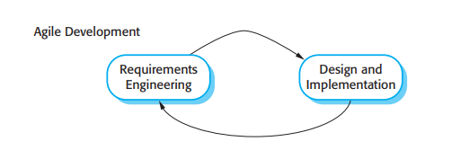
Methodology
Method: Since the logistics and data analysis system is always changing, Agile development enables for adaptability technology and user needs.
Agile allows for continuous improvement and adaptation based on user feedback.

Slide 9
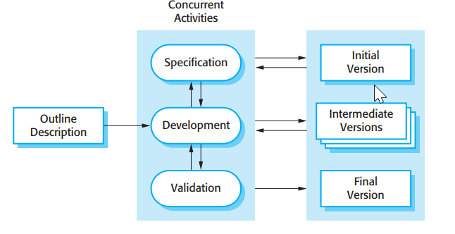
Methodology
Model (Incremental model):
The incremental development process, selected for its flexibility and ability to accommodate change, is ideal for creating an advanced logistics and data analysis system. This approach ensures early value delivery, effective risk mitigation, and continuous feedback, leading to a more adaptable and efficient development process.

Slide 10
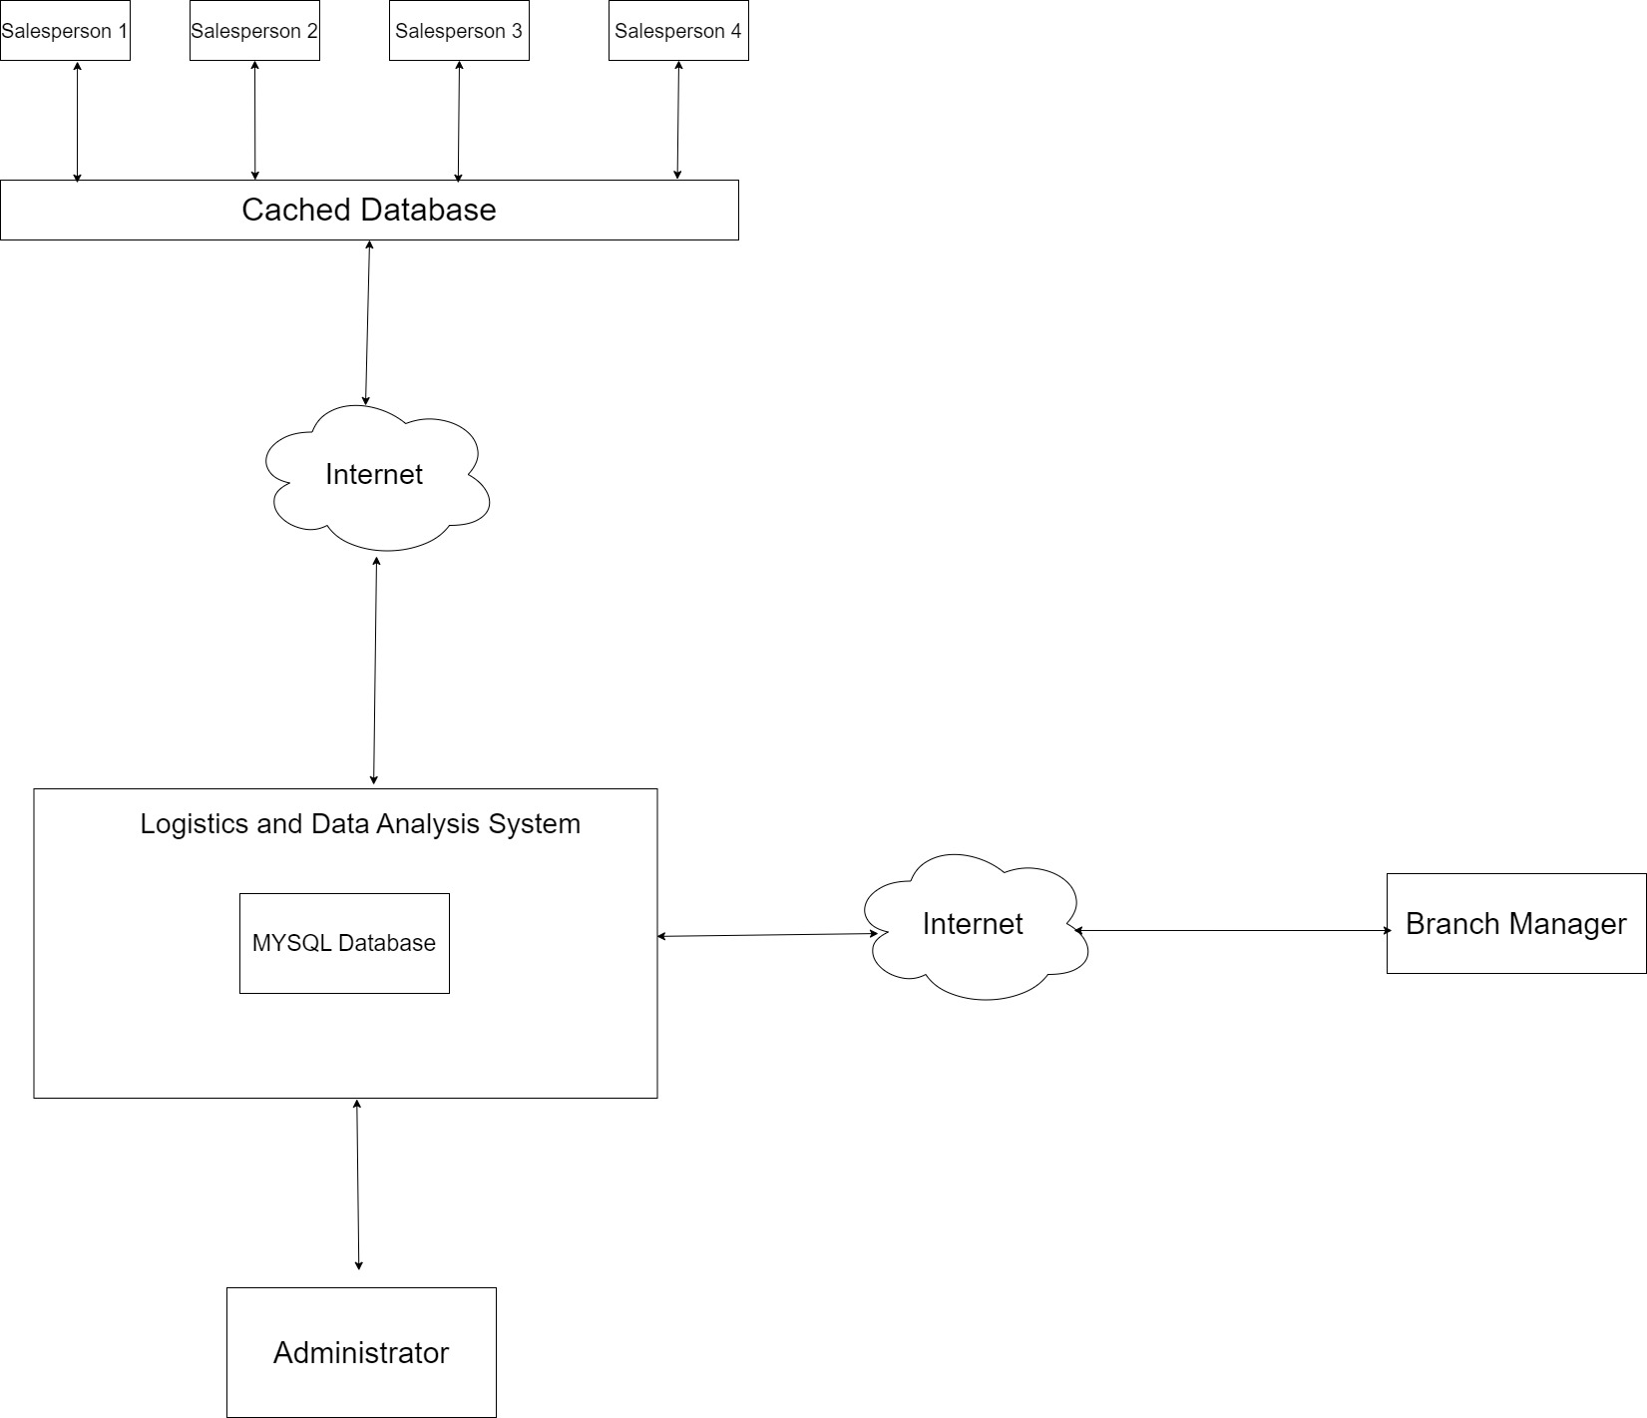
Design and Implementation

Slide 11
Testing
Component Testing
The goal of component testing is to confirm that each system component is operating as intended. In order to isolate flaws early in the development process, this stage is essential. This stage is also known as unit testing.
System Testing
System testing examines the complete system as an integrated unit. It focuses on how the parts of the system work together and how the system behaves as a whole. The system testing involves verifying the complete logistics and data analysis system’s functionalities and performance as a whole, ensuring all integrated components work together seamlessly.

Slide 12
Conclusion
To conclude, the creation and execution of the sophisticated logistics and data analysis system constitute a notable advancement in managing the intricacies of contemporary supply chain administration. The system has demonstrated its capacity to increase operational efficiency, improve decision-making, and save costs by combining state-of-the-art technologies including real-time data processing, predictive analytics, and optimization algorithms. In addition to addressing the logistical issues that businesses are now facing, the initiative also provides them with the tools they need to adjust to changing market conditions and maintain their long-term development and competitiveness. This technology is a significant breakthrough in the logistics industry, providing companies with the chance to go from reactive to proactive operations, which will eventually result in long-term success in a world that is data-driven and changing quickly

Slide 13
References
Kaelbling, L. P., Littman, M. L., & Moore, A. W. (1996). Reinforcement learning: A survey. Journal of Artificial Intelligence Research, 4, 237-285.
Rosenhead, J. (2006). Complexity theory and management practice. In J. Mingers & J. Gill (Eds.), Multimethodology: The theory and practice of combining management science methodologies (pp. 64-87). John Wiley & Sons.
Turban, E., Sharda, R., & Delen, D. (2019). Decision support and business intelligence systems (10th ed.). Pearson
Wild, T. (2021). Best practice in inventory management (3rd ed.). Wiley.
Williams, K., Brown, J., & Lee, H. (2021). Multi-channel order management: A comprehensive approach. Journal of Retail and Distribution Management, 29(4), 88-103. https://doi.org/10.4567/jrdm.2021.04088

Slide 14
Thank you!

